Slide 1
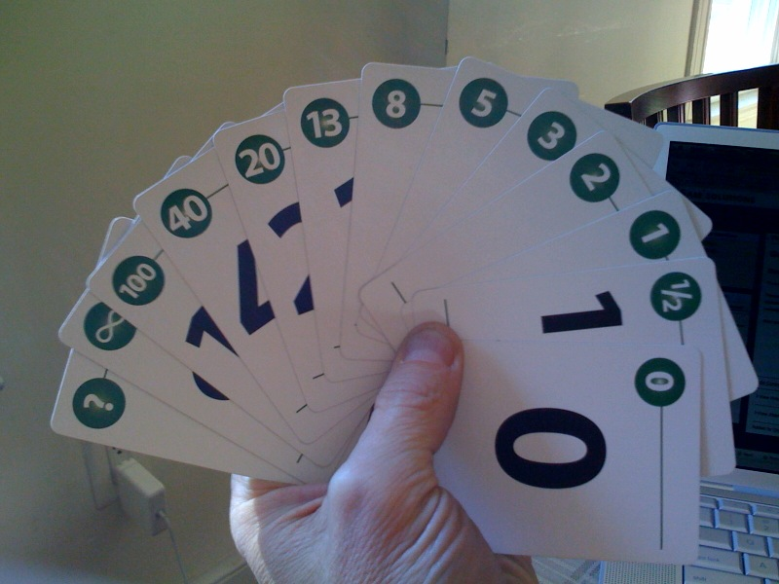
Planning Poker Play, Estimate, Plan
Jay Smith – Tyson Foods, Inc.

Slide 2
Agenda
Estimation as we know it
Equipment
Who is involved
How it goes down
Let’s Play
Benefits
Resources

Slide 3
Estimation as we know it
What we need to know
How long will it take to build?
When will it get done?
What we have today
Complicated mathematical formula’s
Estimation methods that require a PhD
Notes:
Estimation approaches
There are many ways of categorizing estimation approaches, see for example ^{[9][10]}. The top level categories are the following:
Expert estimation: The quantification step, i.e., the step where the estimate is produced based on judgmental processes.
Formal estimation model: The quantification step is based on mechanical processes, e.g., the use of a formula derived from historical data.
Combination-based estimation: The quantification step is based on a judgmental or mechanical combination of estimates from different sources.
Below are examples of estimation approaches within each category.
Analogy-based estimation Formal estimation model ANGEL
WBS-based (bottom up) estimation Expert estimation MS Project, company specific activity templates Parametric models Formal estimation model COCOMO, SLIM, SEER-SEM
Size-based estimation models^{[11]} Formal estimation model Function Point Analysis^{[12]}, Use Case Analysis, Story points-based estimation in Agile software development
Group estimation Expert estimation Planning poker, Wideband Delphi
Mechanical combination Combination-based estimation Average of an analogy-based and a Work breakdown structure-based effort estimate
Judgmental combination Combination-based estimation Expert judgment based on estimates from a parametric model and group estimation

Slide 4

What if you could answer those questions by playing a game with cards?
Notes:
It is a variation of the Wideband Delphi method. It is most commonly used in agile software development, in particular Extreme Programming or Scrum.

Slide 5
Poker Planning
A consensus-based estimation technique for estimating, mostly used to estimate effort or relative size of task in software development.
It is a variation of the Wideband Delphi method.
First described by James Grenning in 2002 and later popularized by Mike Cohn in Agile Estimating and Planning

Slide 6
Poker Planning
A study by K. Mokokken-Ostvold and N.C. Haugen found that estimates obtained through the Planning Poker process were less optimistic and more accurate then estimates obtained through mechanical combination of individual estimates for the same task.

Slide 7
Equipment
A list of features
Planning Poker cards
The Team
Egg Timer (optional)
Notes:
Cards use the Fibonacci sequence to reflect inherent uncertainty in estimating large items.
Cards 1, 2, 3, 5, 8, 13, 20, 40, 100, ? (unsure) and a coffee cup (I need a break)
Optionally an egg timer can be used to limit time spent discussing each item.

Slide 8
Who is involved?
Project Managers/Project Owner
Analyst
Programmers
Testers
Database engineers
User Interaction
Designers
Etc.
Notes:
At the estimation meeting each estimator is given a deck of cards.
The team, which consist of programmers, testers, database engineers, analyst, user interaction, designers, and so on.
At the estimation meeting each estimator is given a deck of cards.
Tell PMO Roadmap story or EIM Re-estimation story

Slide 9
How it goes down
Short overview
Questions and clarify assumptions
Pick a card and place it face down
Everyone reveals their cards
Discuss outliers
Pick new card
Repeat until a consensus is reached
Notes:
At the estimation meeting each estimator is given a deck of cards.
During discussion, numbers must not be mentioned to avoid anchoring.
The developer with the most knowledge about the feature provides a short overview
The team is given opportunity to ask questions and clarify assumptions. The PM keeps notes.
Each individual lays a card face down representing their estimate.
Everyone reveals their cards. There will be differences
People with high and low estimates are given a soap box to offer justification for their estimate and discussion continues.
Each individual lays a card down with their new estimate for this round.
Repeat until a consensus is reached. Usually not more than 3 rounds.

Slide 10
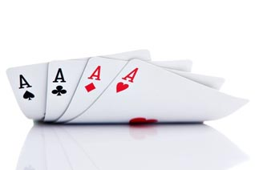
Lets Play
Notes:
What is a requirement?
SLOW DOWN, silence is good
REPEAT FOR AUDIENCE

Slide 11
The Game
Let’s define a feature
As a role
I want to action
So that I can benefit
Notes:
At the estimation meeting each estimator is given a deck of cards.
The team, which consist of programmers, testers, database engineers, analyst, user interaction, designers, and so on.

Slide 12
Benefits
It minimizes anchoring by asking developers to keep estimate card hidden.
Brings together multiple expert opinions
Documents assumptions
Provides quality estimates quickly
It’s fun
Notes:
At the estimation meeting each estimator is given a deck of cards.
The team, which consist of programmers, testers, database engineers, analyst, user interaction, designers, and so on.

Slide 13
Resources
Agile Coaching by Rachel Davies and Liz Sedly
Agile Estimation and Planning by Mike Cohn
Extreme Programming Explained by Kent Beck
Planning Poker In Detail: http://www.planningpoker.com/detail.html
Planning Poker: http://en.widipedia.com/wiki/Planning_poker
My Info:
Blog: http://jaysmith.us
Email: jay@jaysmith.us
Twitter: http://twitter.com/JaySmith

